Slide 1
The mandatory content
Existence of God mandatory content.
Does God exist?
. What arguments/theories do religious people use to prove the existence of God?
. What evidence do religious people use to support these arguments/theories?
. What are the strengths and weaknesses of evidence/arguments/theories?
. What arguments/theories do non-religious people use to challenge the existence of God?
. What evidence do non-religious people use to support these arguments/theories?
. What are the strengths and weaknesses of evidence/arguments/theories?
. Can either religious or non-religious arguments/theories provide conclusive proof about the existence of God?

Slide 2
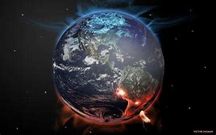
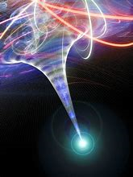
Summary
The universe has a beginning.
The Big Bang = an implosion from a SINGULARITY (a single point of density – all known space was compressed into an infinitely small mass).
Scientists do not know what the singularity was or ‘how long’ it had been there.
This all happened 12-15bn years ago - matter, space, time, were created.

Slide 3
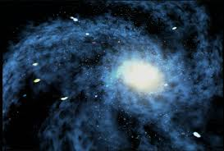
Evidence to support the Big Bang

Slide 4
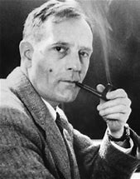
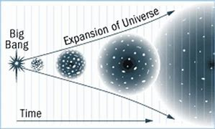

1. The Expanding Universe
Edwin Hubble, an American astronomer, found evidence in 1927
that the universe was expanding.
This means the planets and galaxies are moving away from one another.
This means that space itself is expanding.
Of course, if it is expanding then it must expand from somewhere. Hubble said if we reversed the process we could trace it back to one central point (singularity). This provides strong evidence of a Big Bang. (KU)

Slide 5

2. Cosmic Background Radiation
The second piece of evidence came in 1965 when two radio astronomers found that their reception had a fuzzy noise. They found that this was the same no matter where they placed their radio.
The fuzz seemed to be coming from every part of the universe.
At first they were a bit confused however scientists agreed that this ‘fuzzy noise’ was leftover heat from the big bang in the form of radiation.(KU)
https://www.youtube.com/watch?v=wffIdh0CZWs

Slide 6

For example, think of a sparkler on bonfire night. It gets very hot but so does the air around it.
The sparkler will take time to cool down and so will the heated up air.
Imagine this is the same for the big bang explosion. The background ‘heat’ is still cooling down 12-15billion years later.
This became known as cosmic background radiation and this cosmic background radiation can be observed and measured today, meaning it is empirical evidence and is therefore compelling evidence in proving the Big bang. (KU)
https://www.youtube.com/watch?v=ClDmjQo8nVQ

Slide 7
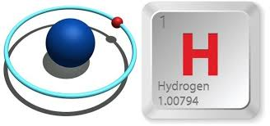
3. The quantity of elements
The universe is made up of different elements, just like ingredients, they are what allow us to exist.
The first two elements to be created were hydrogen and helium but many more developed.
The exact amount of each element in the universe today points to the fact that they were created at some point in the past. (KU)
For example, the amount of hydrogen atoms present in the universe today is exactly what you would expect had the universe been created by the Big Bang.

Slide 8
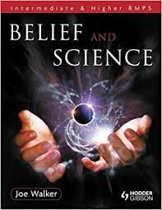
Read the text book “Belief and Science. "Pages 97-100.
Add to your notes any details that help with your understanding.

Slide 9


The Big bang
Strengths & Weaknesses
STRENGTHS | WEAKNESSES

Slide 10

In pairs think about some of the strengths and weaknesses of The Big Bang Theory.
Add them under your headings.

Slide 11
Strengths
1. Strong scientific and rational basis for the theory. Observation, verification, repeated experiments, analysis, reasoning.
2. It explains ‘how’ the universe exists now.
3. It dismisses supernatural speculation. (guesswork).

Slide 12
Weaknesses
1. Based on limited observable evidence. Eg Can’t measure light from the first 10% of the explosion. Limited evidence to support the theory.
2. Big bang is too complex for people to ‘fully’ understand.
3. Gives no explanation to meaning or purpose. It describes the ‘how’(to a point) not the ‘why’.

